Slide 1
Full Stack Application Development
Application Development- Introduction
Web application architectures
Application Programming Interface
Akshaya Ganesan

Slide 2
Application Programming Interface

Slide 3
API
API stands for ‘Application Programming Interface’.
API: an interface to access whatever resource it points to: data, server software, or other applications.
In an internet-connected world, web and mobile applications are designed for humans to use.
APIs are designed for other digital systems and applications to use.

Slide 4
What is a API?
An API is a software intermediary that allows two applications to talk to each other.
API is the messenger that delivers your request to the provider that you’re requesting it from and then delivers the response back to you.
An API is independent of their respective implementations.
Changing the underlying implementation can be done without affecting the users.
APIs make it possible to integrate different systems together.

Slide 5
API
In this metaphor, a customer is like a user, who tells the waiter what they want.
The waiter is like an API,
receiving the customer’s order.
translating the order into easy-to-follow instructions and conveys it to the kitchen
The kitchen is like a server that creates the order in the manner the customer wants it.
When the food is ready, the waiter picks up the order and delivers it to the customer.
Similarly, the API delivers the response.

Slide 6
Types- Public API
Twitter API, Facebook API, Google Maps API, and more
Granting Outside Access to Your Assets
Provide a set of instructions and standards for accessing the information and services being shared
Making it possible for external developers to build an application around those assets
Much more restricted in the assets they share, given they’re sharing them publicly with developers around the web

Slide 7
Types- Private API
Self-Service Developer & Partner Portal API
Far more common (and possibly even more beneficial, from a business standpoint)
Give developers an easy way to plug right into back-end systems, data, and software
Letting engineering teams do their jobs in less time, with fewer resources
All about productivity, partnerships, and facilitating service-oriented architectures

Slide 8
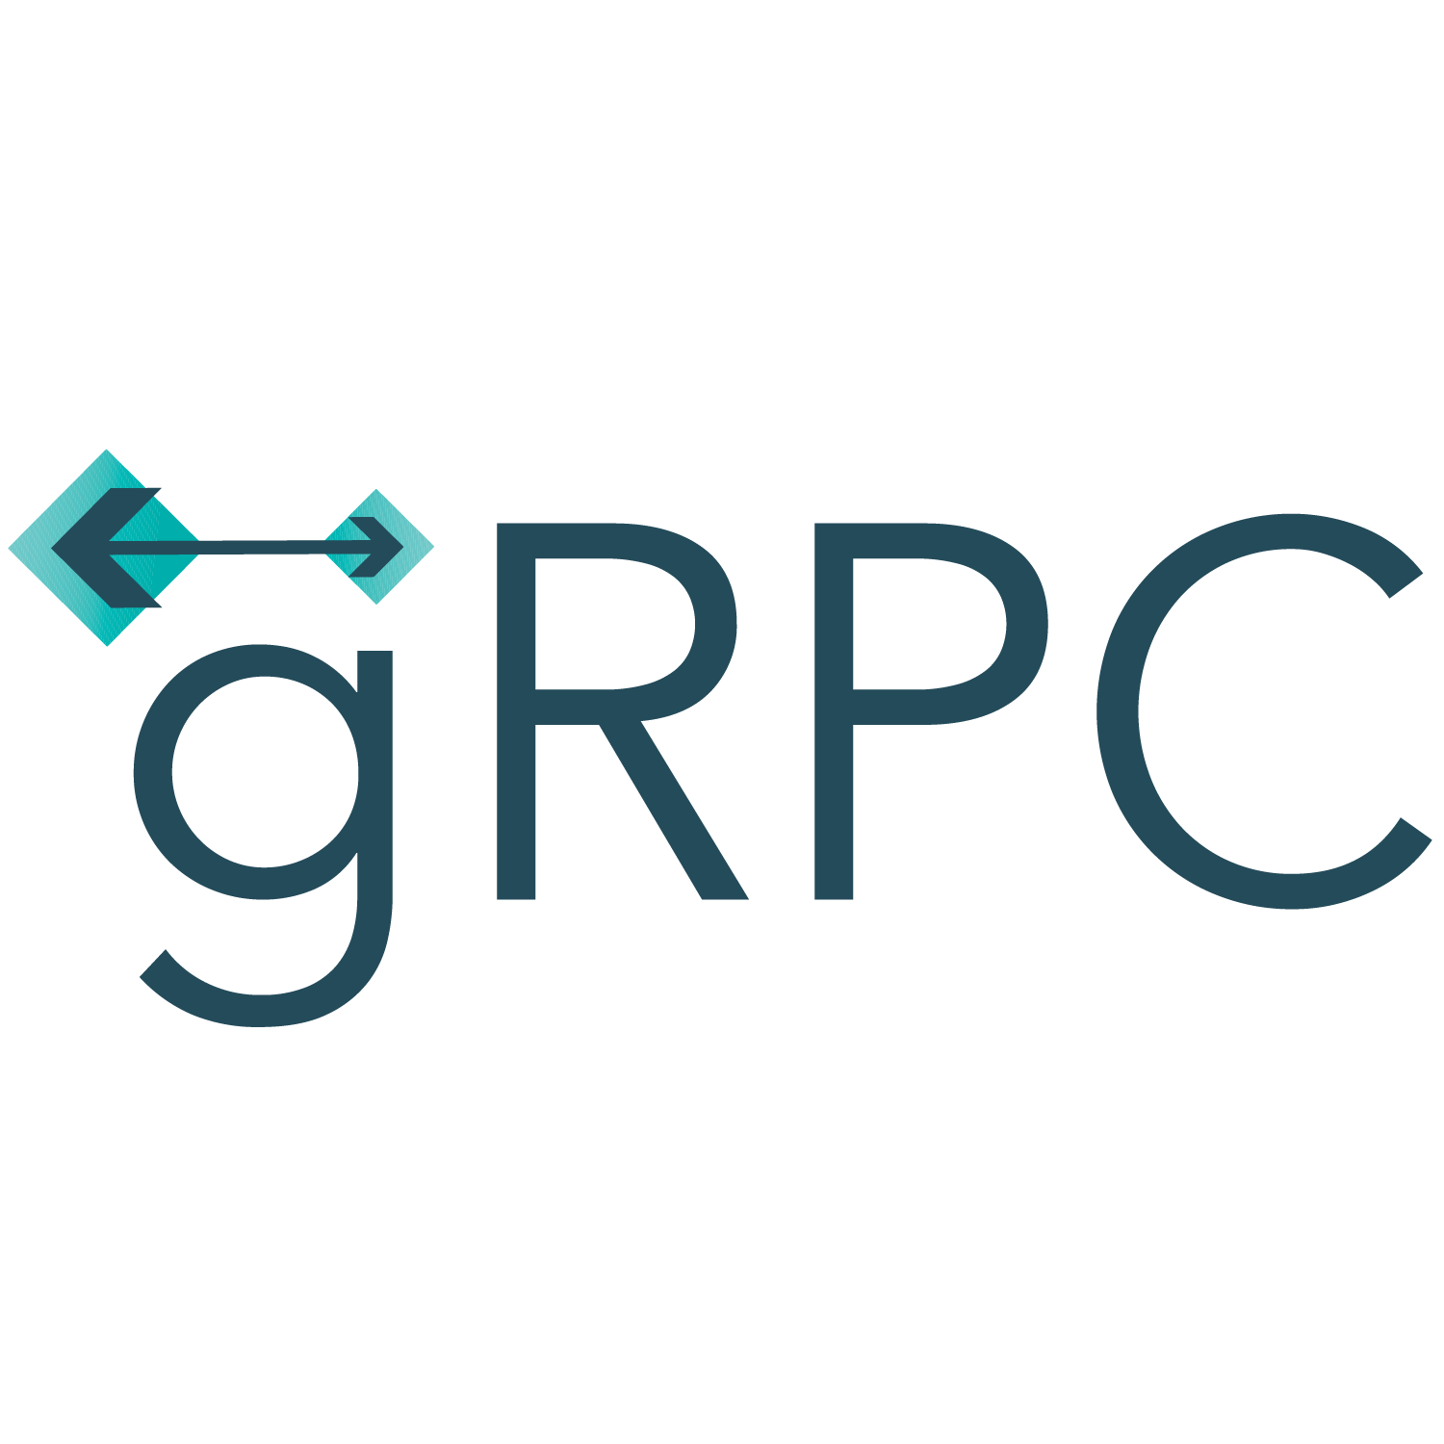
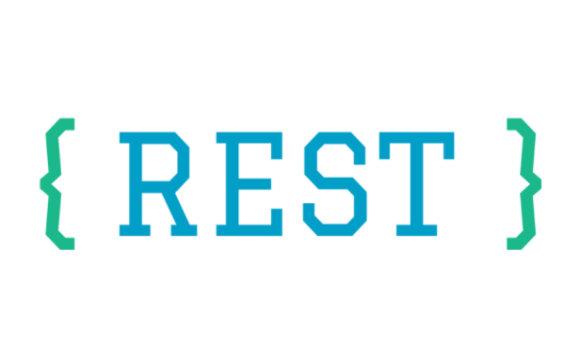

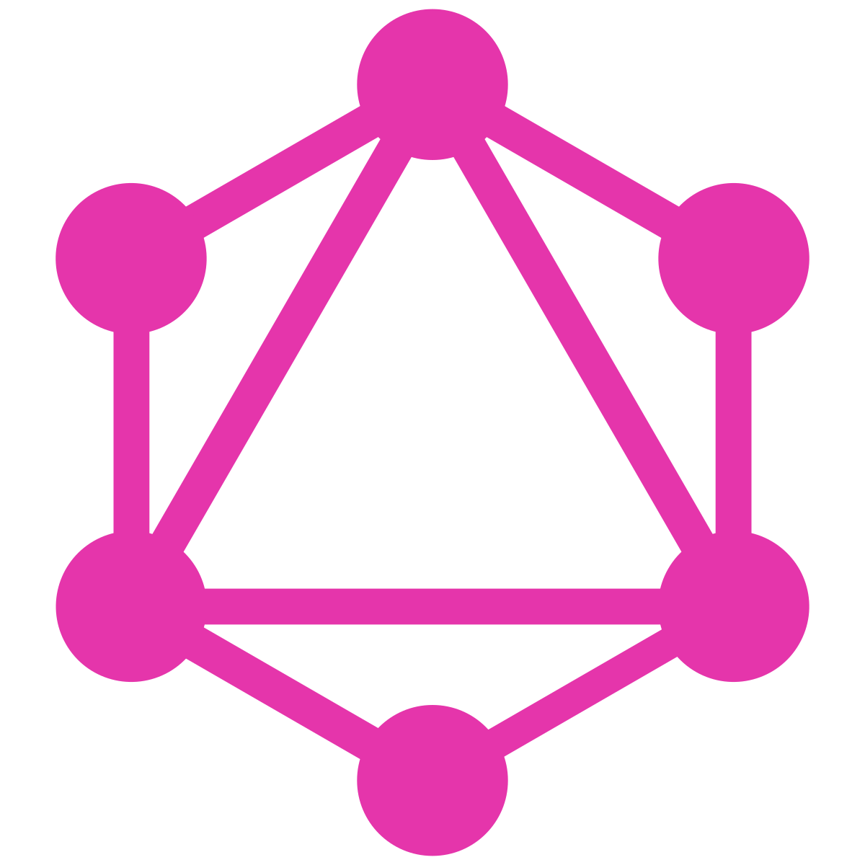
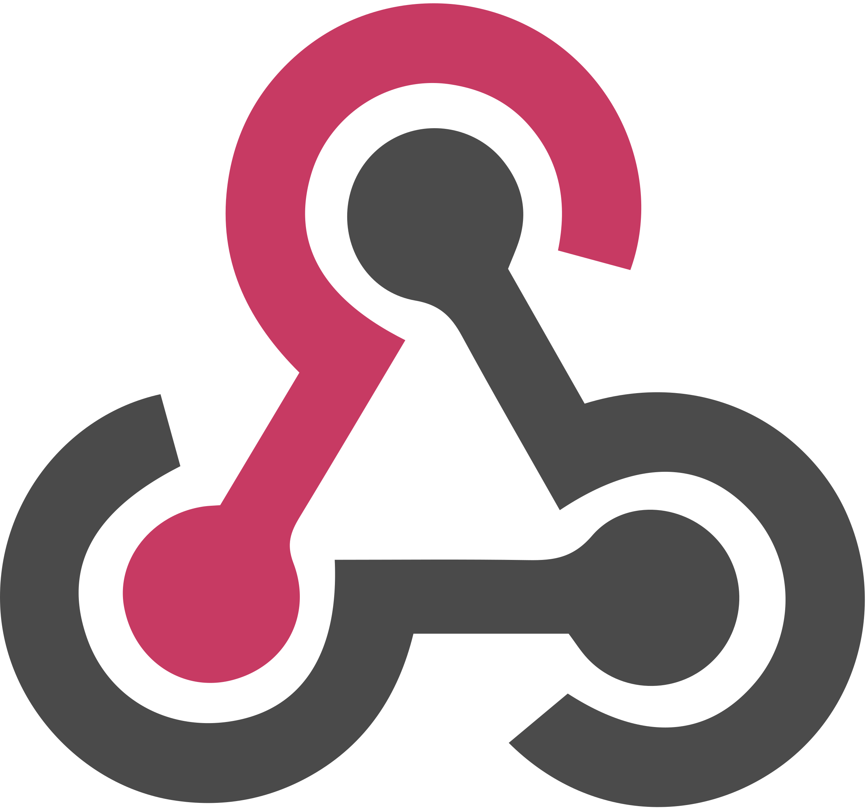
API Paradigm
Over the years, multiple API paradigms have emerged such as :
GraphQL
WebHooks

Slide 9
API Paradigm
Broadly can be classified as
Request-Response APIs
Event Driven APIs

Slide 10
Request-Response APIs
Typically expose an interface through a HTTP-based web server
APIs define a set of endpoints
Clients make HTTP requests for data to those endpoints
Server returns responses
The response is typically sent back as JSON or XML
Three common paradigms used to expose request–response APIs:
GraphQL

Slide 11
Event Driven APIs
Apps which want to stay up to date with the changes in data on server side often end up polling the API.
With polling, apps constantly query API endpoints at a predetermined frequency and look for new data.
If poll is done at a low frequency, apps will not have data about all the events happened since last poll.
If poll is done at a high frequency, would lead to a huge waste of resources, as most API calls will not return any new data.

Slide 12
Event Driven APIs
To share data about events in real time,
three common mechanisms are used :
WebHooks
WebSockets
and HTTP Streaming.

Slide 13
Application Programming Interface

Slide 14
Thank You!

